Slide 1

Study of Determining the Tax Burden Depending on Production Capacity under Uncertainty
the 6th International Conference on
Fuzzy Systems and Data Mining (FSDM 2020)
FSDM ****
Presented by : prof., A.F.Musayev
Affiliation: Department of Mathematical Provision of Economic Research, the Institute of Economics of Azerbaijan National Academy of Science (ANAS), Azerbaijan
1

Slide 2

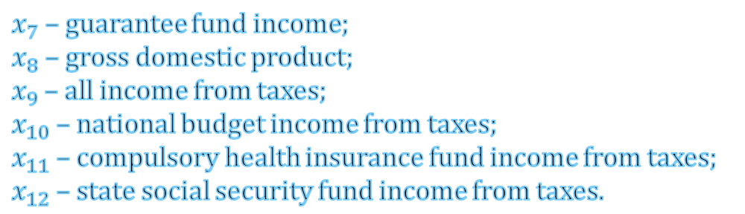
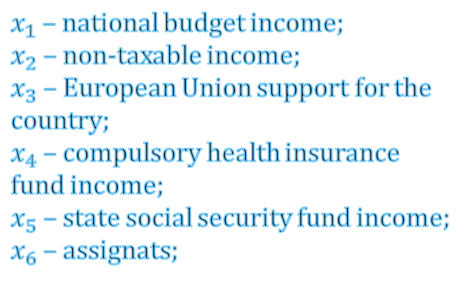
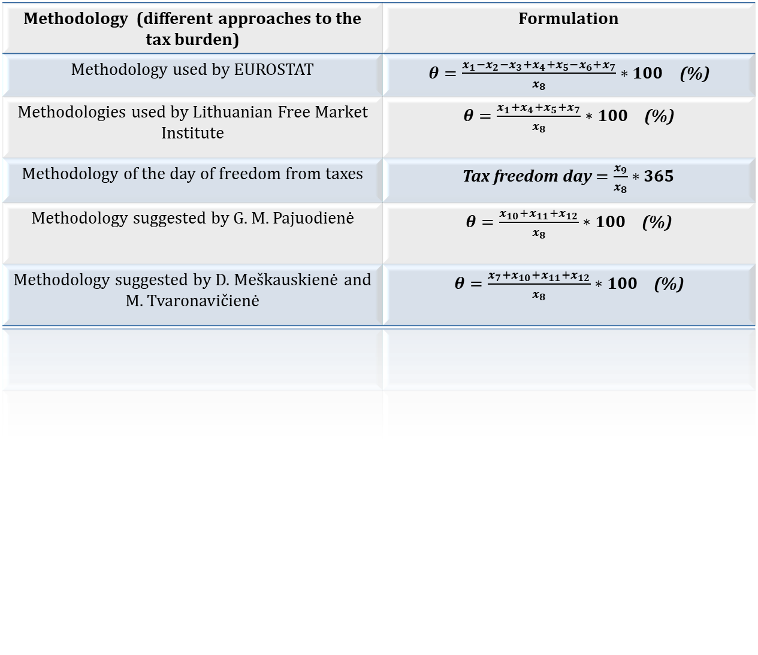
INTRODUCTION
FSDM ****
Methodology (different approaches to the tax burden) | Formulation
Methodology used by EUROSTAT | $θ=\frac{x_{1}−x_{2}−x_{3}+x_{4}+x_{5}−x_{6}+x_{7}}{x_{8}}∗100$ (%)
Methodologies used by Lithuanian Free Market Institute | $θ=\frac{x_{1}+x_{4}+x_{5}+x_{7}}{x_{8}}∗100$ (%)
Methodology of the day of freedom from taxes | Tax freedom day $=\frac{x_{9}}{x_{8}}∗365$
Methodology suggested by G. M. Pajuodienė | $θ=\frac{x_{10}+x_{11}+x_{12}}{x_{8}}∗100$ (%)
Methodology suggested by D. Meškauskienė and M. Tvaronavičienė | $θ=\frac{x_{7}+x_{10}+x_{11}+x_{12}}{x_{8}}∗100$ (%)
$x_{1}$ – national budget income;
$x_{2}$ – non-taxable income;
$x_{3}$ – European Union support for the country;
$x_{4}$ – compulsory health insurance fund income;
$x_{5}$ – state social security fund income;
$x_{6}$ – assignats;
$x_{7}$ – guarantee fund income;
$x_{8}$ – gross domestic product;
$x_{9}$ – all income from taxes;
$x_{10}$ – national budget income from taxes;
$x_{11}$ – compulsory health insurance fund income from taxes;
$x_{12}$ – state social security fund income from taxes.
2

Slide 3
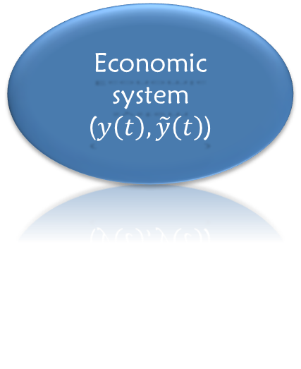
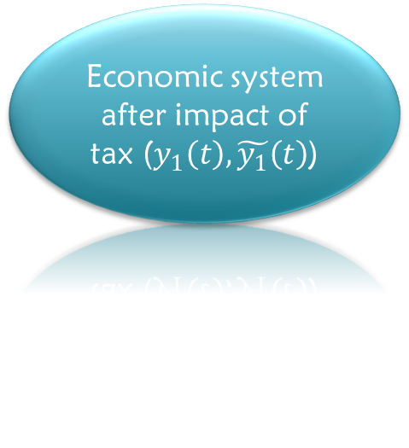
FSDM****
Displacement of the economic system
under impact of tax
tax regime
$y_{1}\left(t\right)=u\left(t\right)y\left(t\right) −$ ordinary economic system
Economic system ($y\left(t\right),\tilde{y}\left(t\right)$)
Economic system after impact of tax ($y_{1}\left(t\right),\tilde{y_{1}}\left(t\right)$)
$\tilde{y_{1}}\left(t\right)=u\left(t\right)\tilde{y}\left(t\right)−$ for fuzzy economic system
3

Slide 4


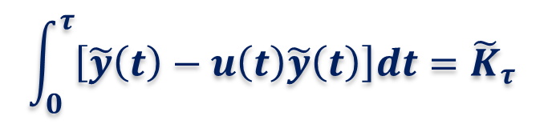
OBJECTIVES
FSDM****
Equilibrium model expressing the fuzzy economic potential of a fuzzy economic system
$$\int_{0}^{τ}{\left[\tilde{y}\left(t\right)−u\left(t\right)\tilde{y}\left(t\right)\right]dt={\tilde{K}}_{τ}}$$
4

Slide 5

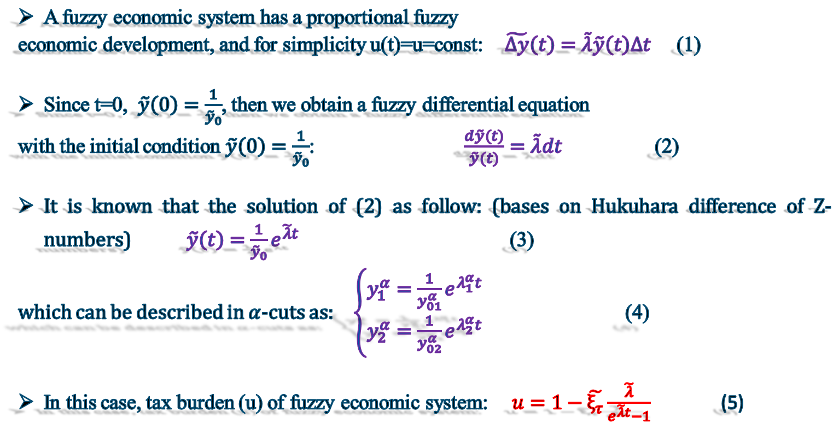
METHODOLOGY
FSDM ****
A fuzzy economic system has a proportional fuzzy
economic development, and for simplicity u(t)=u=const: $\tilde{∆y}\left(t\right)=\tilde{λ}\tilde{y}\left(t\right)∆t$ (1)
Since t=0, $\tilde{y}\left(0\right)=\frac{1}{{\tilde{y}}_{0}}$, then we obtain a fuzzy differential equation
with the initial condition $\tilde{y}\left(0\right)=\frac{1}{{\tilde{y}}_{0}}$: $\frac{d\tilde{y}(t)}{\tilde{y}(t)}=\tilde{λ}dt$ (2)
It is known that the solution of (2) as follow: (bases on Hukuhara difference of Z-numbers) $\tilde{y}\left(t\right)=\frac{1}{{\tilde{y}}_{0}}e^{\tilde{λ}t}$ (3)
which can be described in $α$-cuts as: $\left\{\begin{aligned}y_{1}^{α}=\frac{1}{y_{01}^{α}}e^{λ_{1}^{α}t} \\ y_{2}^{α}=\frac{1}{y_{02}^{α}}e^{λ_{2}^{α}t}\end{aligned}\right.$ (4)
In this case, tax burden (u) of fuzzy economic system: $u=1−\tilde{ξ_{τ}}\frac{\tilde{λ}}{e^{\tilde{λ}t}−1}$ (5)
5

Slide 6

RESULT AND DISCUSSIONS
FSDM****
6

Slide 7
RESULT AND DISCUSSIONS
FSDM****
Years | World bank data Tax burden rate (for Azerbaijan)
2009 | 40.9%
2010 | 38.9%
2011 | 40%
2012 | 40%
2013 | 39.8%
2014 | 39.8%
2015 | 39.8%
2016 | 39.8%
2017 | 39.8%
7

Slide 8

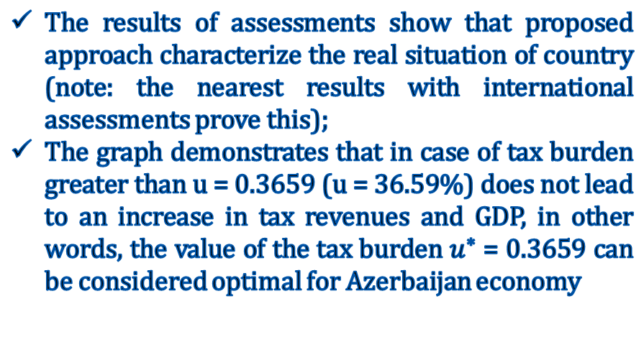
Conclusion
FSDM ****
The results of assessments show that proposed approach characterize the real situation of country (note: the nearest results with international assessments prove this);
The graph demonstrates that in case of tax burden greater than u = 0.3659 (u = 36.59%) does not lead to an increase in tax revenues and GDP, in other words, the value of the tax burden $u^{∗}$ = 0.3659 can be considered optimal for Azerbaijan economy
8

Slide 9
FSDM ****
Thank you for your attention

