Slide 1
Leading researcher, Ph.D. in Economics
Emin Mammad-zadah
"Actual directions of scientific and technical cooperation within the BSEC“

Slide 2
I. Safe, clean and efficient energy

Slide 3
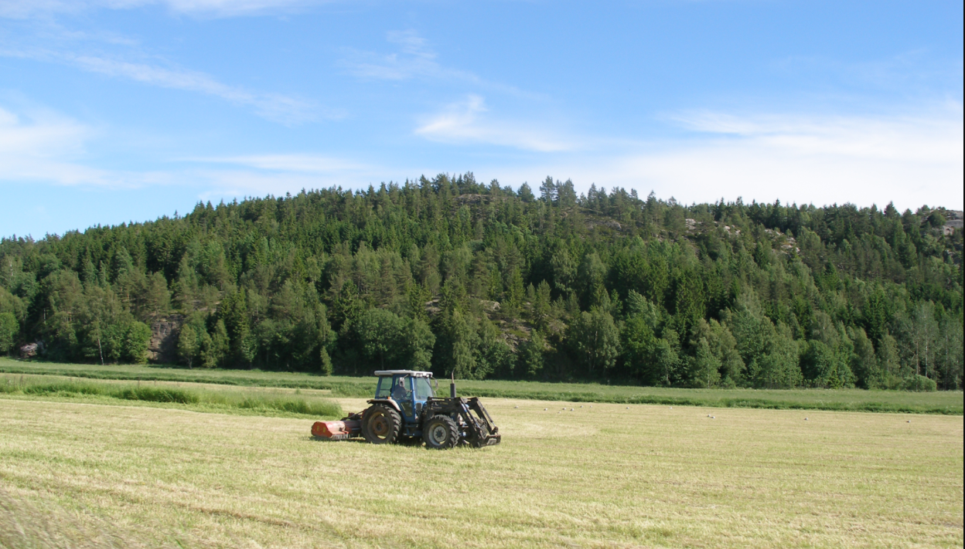
II. Food safety, agriculture and forestry, aquatic ecosystems and bioeconomy

Slide 4
III. Combating the effects of climate change, efficient use of resources and raw materials

Slide 5
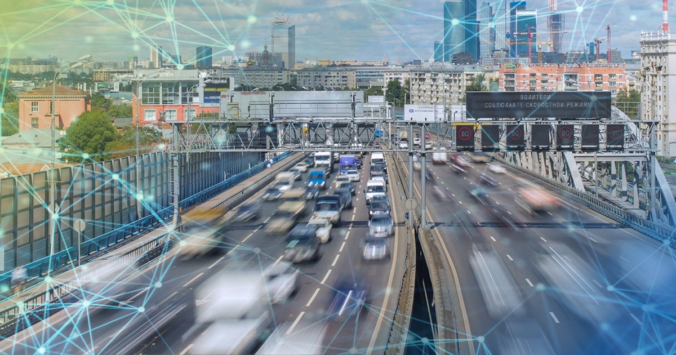
IV. Environmentally friendly intelligent transportation

Slide 6
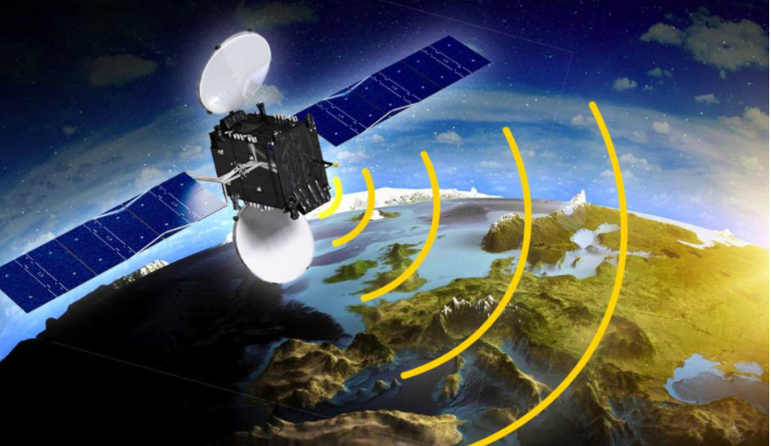
V. Satellites and the use of the results of space activities

Slide 7
Thank you for attention!

