Slide 1
Institute of Economics of ANAS
AGIL EYVAZOV
PhD, Associate professor
WHY TO INVEST IN AZERBAIJAN?
ECONOMİC REFORMS. BUSINESS AND INVESTMENT CLİMATE

Slide 2
AZERBAIJAN ECONOMY AT A GLANCE (GDP growth)
1991-1994
1995-2003
2004-2010
2011-2015
2016
2017
2019-2020
70
forecast
-17%
5. 9%
16. 9%
2 . 4%
-3.1%
0,1%
2,87%
60
new
rebalacing of
Comprehensive economic reform period
economic the economy;
model;
Nominal GDP, bn. manats
boomed economic growth;
high to medium income country;
modern infrastructure;
leading reformist country;
macroeconomic stability.
macroeconomic
50 regional instability;
high inﬂation;
from
stability.
transferring
economic growth to non-oil sector;
slow growth rate.
resource-
based to
40
unemployment.
productivity
further
diversiﬁcation of the economy
political stability;
based;
30
state building;
macroeconomic stability.
from ﬁxed
recovery of
to ﬂexible
the economic
20
exchange
growth;
rate.
10
strengthening
governemnt
institutes.
0
Source: State Statistical Committee, Ministry of Finance, Central Bank of the Republic of Azerbaijan
2018
2019
2020
2.4
IMF forecast
2.1
1.8
0
1
2

Slide 3
MACROECONOMIC AND FINANCIAL STABILITY RESTORED
Lowering dependency on the oil revenues
(mln. manat)
11350
9337 ₈₁₃₀
Bank capitalization
(thsd. manats)
3925
Key characteristics
2018 (Q-2)
Foreign Trade Balance is at $4 billion:
stable oil prices; import substitution; non-oil export rising:
- services (incl. tourism).
Increasing international reserves:
IR stands at $44 bn.; IR/Import equals 35 months*;
IR/state foreign debt is 3 times*.
Exchange rate exhibits low volatility;
Sufﬁcient capital level in the banking system has been ensured;
Proﬁtability of the banking sector has been restored.
26%
9905
7615
1909
9000
22%
23% 23%
4915
23%
5915
585 585
3800
19% 19% 18% _{17%} 19% 18%
2016
2018 (Q-3)
2006 2007 2008 2009 2010 2011 2012 2013 2014 2015 2016
Non-oil budget/non-oil GDP SOFAZ transfers
Banking sector proﬁtability
Source: Ministry of Finance of the Republic of Azerbaijan
Strengthened Balance of Payments
(mln. USD)
17146
14916
77
2018 (Q-3)
12304 10431
1967
1326
2018 (Q-2)
2016
1695 1556
201 463
2014 2015 2016 2017 2018
-3419 ⁻²⁷⁶¹ (Q-1)
-223
-1364
2011 2012 2013
-4790 ₋₆₄₈₉
-9961
-9025
-1668
Current account Financial account Change in reserve assets
Source: Central Bank of the Republic of Azerbaijan
Source: Financial Market Supervisory Authority of the Republic of Azerbaijan

Slide 4
TRANSLATING ECONOMIC GROWTH INTO SOCIAL DEVELOPMENT OVER THE PAST YEARS
Post recovery economic growth has successfully channeled into poverty reduction…
... consequently, improving living standards
Real GDP
billion USD (2000=100)
In nominal terms (2003=100 2017)
Poverty
%
_{23.6} 23.8
22.9
23.1 _{23.1}
Minimum wage
13
times
49%
20.2
21.2 21.2 ^{21.7}
46,7%
44.7%
40.2%
18.5
16.7
Average monthly wages
6.8
times
13.3
29.3%
9.9
20.8%
Average monthly pension
8.6
times
7.1
7.8
15.8%
5.8
6.4
13.2%
7.6% _{6%}
Unemployment rate*
2
times
10.9%
5.3%
9.1%
5% 4.9% 5.9% 5.4%
2001 2002 2003 2004 2005 2006 2007 2008 2008 2010 2011 2012 2013 2014 2015 2016 2017
* 2016/2003
Azerbaijan’s 2015 Human Development Index value is 0.759 – which puts the country in the high human development category – ranking 78 out of 188 countries and territories.
Source: State Statistical Committee of the Republic of Azerbaijan

Slide 5
SIGNIFICANT STEPS HAVE BEEN TAKEN TO MODERNIZE INFRASTRUCTURE IN THE COUNTRY
4 000 km irrigation channels
93 % coverage
Irrigation system
Gas supply
12 300 km road
3 104 schools and
635 hospitals
Schools and hospitals built
or reconstructed
Road infrastructure
7 960 km water line
3 990 km sewerage line
Water supply
Source: various state agencies

Slide 6
INSTITUTIONAL REFORMS ARE FUNDAMENTAL FOR FUTURE ECONOMIC PROGRESS
Financial Stability Council
ensures coordinated policy approach for increasing macroeconomic stability and resilience to external shocks;
ensures preservation of the competitive based economy.
Energy Regulation Agency under
the Ministry of Energy
single regulator in electrical and heat energy as well as gas supply;
provides tariff proposals on electrical and heat energy as well as gas supply to the Tariff (price) Council.
Financial Markets Supervision Authority
improves the quality of the ﬁnance system in response to the new global challenges;
provides an efﬁcient supervision system on the securities market, investment funds, insurance and credit institutions, including banks and non-banks.
Food Safety Agency
improves the existing legislation framework in the ﬁeld of food safety; revises food safety standards to meet international requirements; improves the network of laboratories.
Center for Analysis of Economic Reforms and Communication
ensures expansion of the scope of economic reforms and provides efﬁcient coordination of works in this area;
prepares medium and long-term forecasts;
improves the communication of the economic reforms initiated.
Azerbaijan Mortgage and Credit Guarantee Fund
provides guarantees and subsidies for the loans denominated in national currency to the entrepreneurs operating in non-oil sector of the economy;
provides consulting services to entrepreneurs in debt management, risk assessment and management.

Slide 7
FUTURE OUTLOOK OF AZERBAIJAN ECONOMY
In December 6, 2016 the Strategic Road Maps for National Economy and 11 core sectors have been approved.
Strategic Vision for 2020
Strategic objectives under National Economy Strategic Roadmap envisions...
strengthening ﬁscal sustainability and ensuring a robust monetary policy;
privatization and state-owned enterprise reforms;
development of human capital;
development of more favorable business environment.
“Achieve the stabilization of Azerbaijan’s economy in the short term in order to resolve the situation resulting from adverse eﬀect of the foreign shocks, then to restore the line of development owing
to diversiﬁcation and new drivers in the medium term and to enhance competitiveness by further integrating into the world economy.”
Long-term Vision for 2025
Expected Results by 2025
3% real annual GDP growth;
Creation of 450,000 jobs (1/3 in tradable sectors);
Increase of the share of non-oil foreign direct investment (FDI) in non-oil GDP from current 2,6 percent to 4 percent;
Increase of non-oil exports from less than 170 USD per capita today to at least 450 USD;
Decrease the dependence of state budget on State Oil Fund transfers.
“Long-term vision of the national economy for 2025 is to achieve strengthened competitiveness by creating further value under the circumstances of collaboration of all economic stakeholders in Azerbaijan, which is already on the path of sustainable development.”
Aspirational Vision for post 2025
“Aspirational vision for post 2025 envisages building a strong competitive and inclusive economy ensuring the improvement of social prosperity and maximizing the human development index and based on high technological development and optimum structure of economy.”
Priorities selected for future development of Azerbaijan economy are also in line with the UN Sustainable Development Goals.

Slide 8
STRATEGIC REFORM DIRECTIONS HAVE BEEN DETERMINED
Institutional set-up
Infrastructure
Business environment
Human capital and social welfare
Towards sustainable and inclusive economic development
Sufﬁcient level of capital
Environmental integrity

Slide 9
STRONG INSTITUTIONS SHALL LAY FOUNDATION FOR ECONOMIC PROGRESS
Promoting Rule of Law:
strengthening and increasing transparency and efﬁciency of law enforcement mechanism;
increasing the protection of property rights; strengthening insolvency framework;
improving the capabilities of making legislative forecasts.
Further strengthening the independency of judicial institutions;
Establishment of strong and independent institute of competition;
Further improving regulatory mechanisms:
clear separation of policy, regulation and operational functions of institutions.
Public service provision:
public services are provided through one-stop-shop “ASAN-services”*;
expanding coverage of “ASAN-services”; further digitalization of public services;
online platforms for license and permit granting.
Increasing efﬁciency and effectiveness of the ﬁscal sector operations by introducing:
ﬁscal rules;
medium term expenditure framework; performance based budgeting; medium and long term debt strategy.
Deepening of the corporate governance practices.
* 18 430 daily applications; average service time is 10 minutes

Slide 10
AZERBAIJAN IS ON THE PATH TO FURTHER STRENGTHEN BUSINESS ENVIRONMENT...
The ranking of Azerbaijan has raised by 32 steps and reached 25th place among 190 countries;
Future policy responses
to improve business environment
World Bank`s 2019 Doing Business Report
Enhanced competition:
ensuring level playing ﬁeld conditions; minimizing entry barriers;
improving regulatory framework (adopting Code of Competition).
The position of the country has enhanced by 100 steps for Dealing with construction permits and Getting credit;
Azerbaijan is recognized as the most reformer country, with the number of reforms have been implemented, in Europe and Central Asia, in general,
is acknowledged as top improver globally;
More efﬁcient state regulation mechanism:
improving transparency and administration (tax and customs, etc);
improving statistical infrastructure;
completing further alignment of standards and technical regulations in line with international requirements.
Azerbaijan is ranked in top 10 for Starting a Business and Protecting Minority Investors.
Deloitte’s 2017 Business Outlook in Azerbaijan
With 87 percent of the respondents having a positive view, Azerbaijan’s overall business environment is clearly perceived as positive;
Most of the respondents are optimistic about 2018: 79 percent are expecting improvement.
Action plan prepared by intergovernmental working groups under the Business Commission provides a holistic approach for further improvement of business environment.

Slide 11
…AND ENSURE SUFFICIENT LEVEL OF CAPITAL TO EXPAND BOTH DOMESTIC AND FOREIGN BUSINESS INITIATIVES
Non-oil export promotion:
payment of 3% export promotion fee from the state budget;
improving regulatory and legal framework for the formation of access to foreign markets.
Multiple incentives provided to agricultural sector;
Trade representatives in diplomatic ofﬁces;
Free trade agreements with 9 countries;
Bilateral investment agreements with 48 countries;
Double tax treaties with 51 countries.
Multiple incentives;
Simpliﬁcation of the processes: introduction of the single window; simpliﬁcation of the procedures
Protecting investor rights; Deepening of the privatization process; Integration to global custodians.
Attracting investments
Enhancing ﬁnancial inclusion:
ﬁnancial coverage; ﬁnancial deepening.
Building stable and resilient ﬁnancial system;
Strengthening ﬁnancial infrastructure; Increasing ﬁnancial literacy; Digitalization of ﬁnancial services; Continuously developing ﬁnancial markets.
Increasing access to ﬁnance

Slide 12
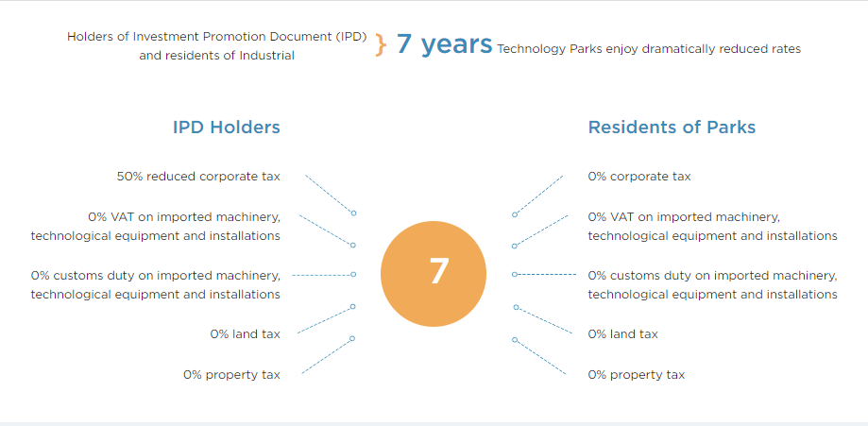
STIMULATIVE INCENTIVE PROGRAMS REPRESENT INVESTMENT FACILITATION STRATEGY…

Slide 13
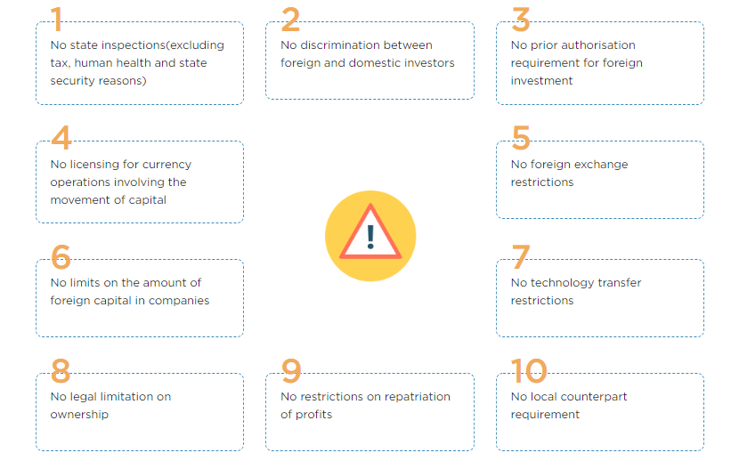
10 "NO" TO SUPPORT INVESTMENT CLIMATE…

Slide 14
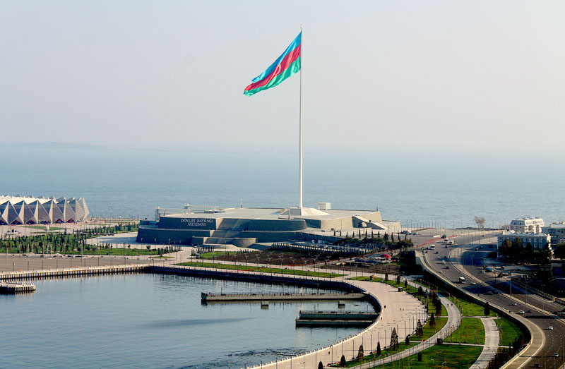
AZERBAIJAN - RIGHT PLACE, RIGHT TIME AND CAPABILITY
Within reach to 50 countries with almost 50% of world consumers within 4-hour ﬂight range.
Azerbaijan has free trade access to
the 270 million consumers of the CIS, with GDP worth 1.6 trillion.
70% of the time is saved between China
and Europe. It is considered to be the shortest linkage both in distance and time.
Logistics hub for the Caspian region with
the biggest airport, seaport, railway network and free-trade zones.

Slide 15
AZERBAIJAN HAS SET A TARGETS OF INCREASING PRODUCTION AND EXPORT POTENTIAL IN THE NEXT FUTURE IN PRIORITY SECTORS OF THE ECONOMY
Priority sectors
Agriculture
Heavy machinery and manufacturing
To establish industry-oriented environmentally friendly agriculture, which will be effectively integrated into the global value chain in the long run through introducing suitable business environment for agriculture and agro-processing in the short term.
To transform the heave industry and machinery manufacturing enterprises of Azerbaijan into an integral part across the global value chain in the long run by enabling to meet a large portion of demand of domestic consumers in low and medium-value product segments and increasing the share of Azerbaijani products in
the regional market in the short term.
Petrochemical industry
Tourism
In the long run, to become one of the most preferred 20 touristic locations in the world by ensuring realization of tourism potential for the entire country, speciﬁcally in Baku in short term.
To increase production and export of value added downstream capacity through expanding production of polymers in primary form and fertilizers, reconstruction and modernization of ethylene and polyethylene production capacity, as well as improving human capital in petrochemical industry.

Slide 16
FURTHER IMPROVEMENT OF INFRASTRUCTURE VIA INCREASED PRIVATE SECTOR PARTICIPATION
Further improvements that will lead to
Becoming regional logistic trade hub
infrastructure development
Introduction of the Build-Operate- Transfer model;
Continuous establishment of the clusters:
5 industrial zones and 4 industrial sites; 3 high technological parks;
agroparks;
free trade zone to be established in Baku Sea Port.
Capturing the higher value and volume from the transit trade by:
the completion of three main projects*; improvement of logistics operations; establishment of trade-focused processing hub and logistics centers in Baku.
Infrastructure development
“Digital Trade Hub of Azerbaijan” is an electronic trade platform that aims to facilitate local, regional and international e-commerce.
Enhancing utility supply
Improving the regulatory–legal framework through:
enhancing the functional efﬁciency of regulatory authorities;
optimizing tariffs and developing incentivizing tools.
Improving institutional environment and progressive management systems by:
ensuring generation and diversiﬁcation of distribution across each area in utilities sector.
Generation of fully – diversiﬁed and environmentally friendly electrical energy
Becoming a leading
ICT-driven country
creating a technology-oriented educational landscape;
enabling further development of digitized economy;
driving growth in banking, ﬁnancial, educational, medical and social sectors in the country and achieving wider use of electronic services.
The UN General Assembly has passed a resolution supporting Azerbaijan's initiative on establishment
of Eurasian Alliance and construction of Trans-Eurasian
Information Super Highway (TASIM).
* Baku-Tbilisi-Kars (BTK) railway, Astara, Iran–Astara, Azerbaijan Railroad construction projects have been ﬁnalized; Baku International Seaport project is ongoing

Slide 17
ENSURING SOCIAL CONTRACT BETWEEN GOOD GOVERNANCE AND SMART CITIZENS SHALL LEAD TO AN INCLUSIVE ECONOMIC GROWTH
Improving quality at all levels of education:
building stronger VET system based on school and employer partnerships;
promoting “education-research-innovation” triangle.
High–Quality
Improving digital infrastructure;
Enhancing e-learning and distant education; Inclusive education for children with disabilities; Promoting life-long learning;
Ensuring long term equilibrium between education and labor market.
Education
Human capital development
Improving quality in healthcare system:
high skilled personnel and modern infrastructure; patient-centered services.
Cutting-edge
and affordable
healthcare
Making healthcare services more affordable:
Mandatory Healthcare Insurance introduced.

Slide 18
ANAS
INSTITUTE OF ECONOMICS
THANKS for attention!
www.economics.com.az May 14, 2019

