Slide 1
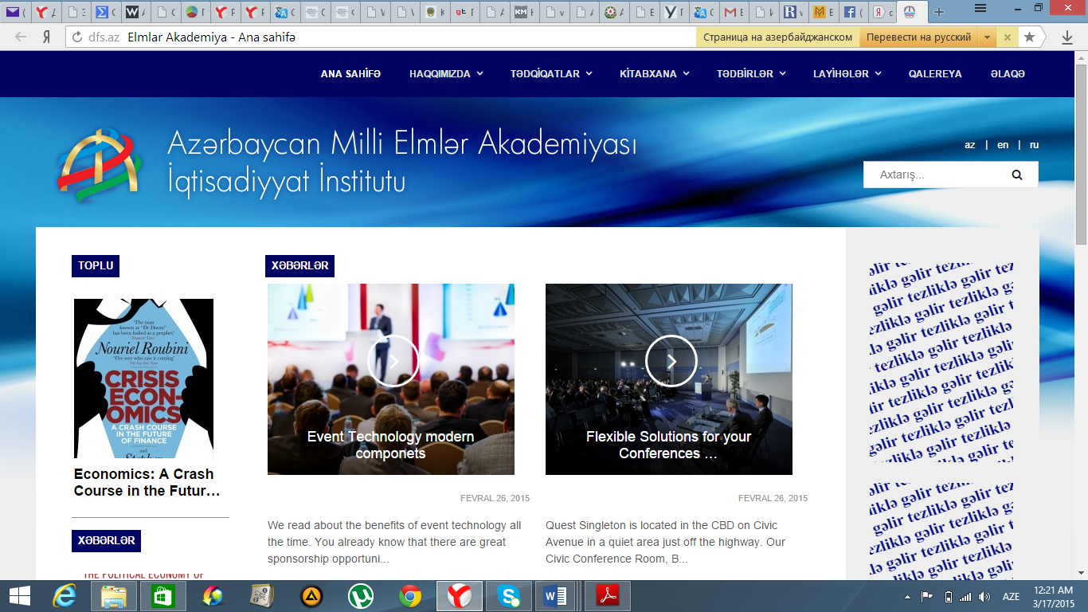

The Institute of Economics
Azerbaijan National Academy of Sciences
Mayis Gulaliyev, PhD
Baku, Azerbaijan
INDEX of LEFTNESS (RIGHTNESS)
of ECONOMY
( The methodology for measurement of
the state intervention in economy)
24th World Congress of Political Science
July 23-28, 2016 - Poznań, Poland

Slide 2
The Institute of Economics
Azerbaijan National Academy of Sciences
ESSENCE of IDEA
Two opposing ideologies of the political economy
A priority should be given to mechanisms of the free market self-regulation, and the government must interfere in economy as less as possible
To prevent market failures and eliminate negative consequences of market imperfection the government must actively interfere in economy and regulate it
Theoretical basis
Neoclassical economics
Neo-Keynesian economics
Carriers
Right-wing political organizations (parties), public organizations and experts
Left-wing political organizations (parties), public organizations and experts
economics.com.az
24th World Congress of Political Science - July 23-28, 2016 | Poznań, Poland

Slide 3
The Institute of Economics
Azerbaijan National Academy of Sciences
ESSENCE of IDEA
Not only the economic ideologies, but economies themselves may be and ARE of left or right-wing
Leftness (Rightness) of economy is determined by the level of certain forms of the government interference in economy
These forms of the government interference are those that shape different economic models – liberal on the right, and administrative on the left
The lower the level of the government interference, the more liberal (righter) is economy of a particular country, and the higher this level, the more administrative (lefter) is economy
Only those forms of government regulations that move an economy towards left or right are subjects for political (ideological) competition between the lefts and the rights
Leftness (rightness) of economy, as well as of political beliefs, in all cases is relative: One party’s views are lefter that other’s, or economy A is righter than economy B
economics.com.az
24th World Congress of Political Science - July 23-28, 2016 | Poznań, Poland

Slide 4
The Institute of Economics
Azerbaijan National Academy of Sciences
ESSENCE of IDEA
LEFTNESS and RIGHTNESS of economy
1,0
Leftness of economy
40 : 60
0,5
60 : 40
Rightness of economy
0,0
protection of domestic market (100%)
Liberalization of foreign trade (0%)
Liberalization of foreign trade (100%)
Protection of domestic market(0%)
Real ratio between protection
of domestic market
and liberalization of foreign trade
Assessment of national economies by their Leftness or Rightness degree gives to us possibility to say:
Having “leftness” or “Rightness” economy does not mean being “good” or “bad” economy;
Some national economies can reach success in Left, another in “Right”
economics.com.az
24th World Congress of Political Science - July 23-28, 2016 | Poznań, Poland

Slide 5
The Institute of Economics
Azerbaijan National Academy of Sciences
Measurement methodology
Leftness (Rightness) Index of Economy-L(R)IE is measured by six sub-indices:
Public Finance Sub-Index ;
Price Regulation Sub-Index;
Foreign Trade Sub-Index;
Licensing Sub-Index;
Employment Regulation Sub-Index;
Minimum Wage Sub-Index.
economics.com.az
24th World Congress of Political Science - July 23-28, 2016 | Poznań, Poland

Slide 6
The Institute of Economics
Azerbaijan National Academy of Sciences
Opportunities of the METHODOLOGY
By measuring of the INDEX of Leftness (Rightness) of Economy for any country we can assess:
effectiveness of adopted political LEFT or RIGHT decisions;
effectiveness of adopted LEFT or Right economic policies and laws;
of optimal degree for state intervention in economy to provide its sustainable development;
of reality of the election promises on economy of LEFT or RIGHT political parties and candidates;
of forecasting of the end of election process where LEFT and RIGHT candidates are fighting;
of forecasting of the trend of any country’s economic development.
economics.com.az
24th World Congress of Political Science - July 23-28, 2016 | Poznań, Poland

Slide 7
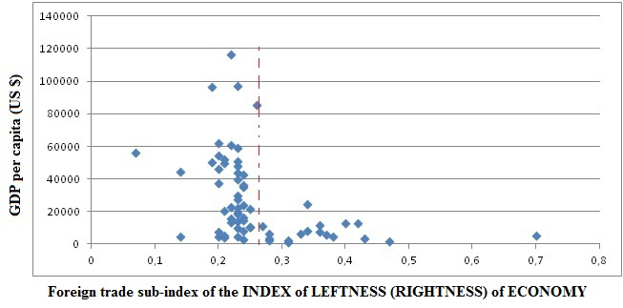
The Institute of Economics
Azerbaijan National Academy of Sciences
Some Results on sub-indices
(Foreign Trade sub-index)
it is NECESSARY condition (but is not a sufficient condition !) moving to RIGHT on foreign trade more than 0,27 to have GDP per capita more than 20.000 US dollars;
economics.com.az
24th World Congress of Political Science - July 23-28, 2016 | Poznań, Poland

Slide 8
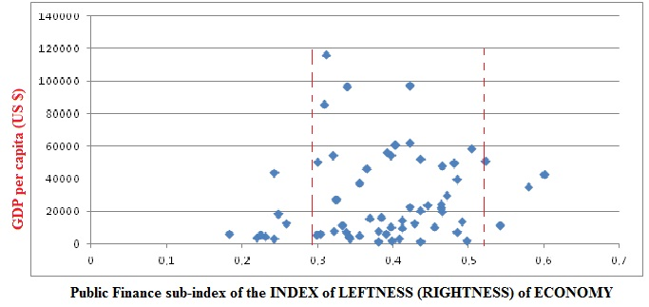
The Institute of Economics
Azerbaijan National Academy of Sciences
Some Results on sub-indices
(Public finance sub-index)
It is NECESSARY condition (but is not a sufficient condition !) to have Public finance sub-index at the interval 0,3-0,5 to have GDP per capita more than 40.000 US $.
economics.com.az
24th World Congress of Political Science - July 23-28, 2016 | Poznań, Poland

Slide 9
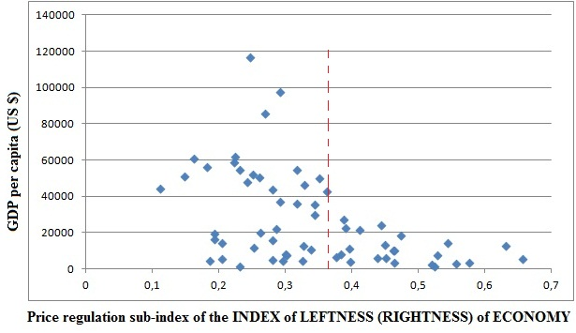
The Institute of Economics
Azerbaijan National Academy of Sciences
Some Results on sub-indices-
(Price regulation sub-index)
It is NECESSARY condition (but is not a sufficient condition !) to have Price regulation sub-index less than 0,37 to have GDP per capita more than 40.000 US $.
economics.com.az
24th World Congress of Political Science - July 23-28, 2016 | Poznań, Poland

Slide 10
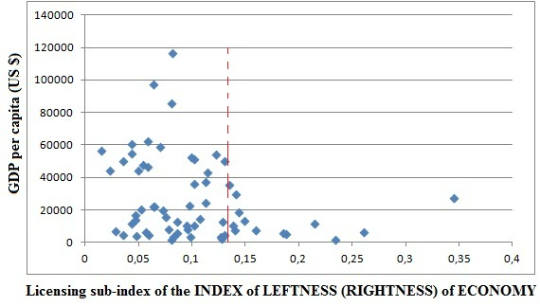
The Institute of Economics
Azerbaijan National Academy of Sciences
Some Results on sub-indices
(Licensing sub-index)
It is NECESSARY condition (but is not a sufficient condition !) to have Licensing sub-index less than 0,13 to have GDP per capita more than 40.000 US $.
economics.com.az
24th World Congress of Political Science - July 23-28, 2016 | Poznań, Poland

Slide 11
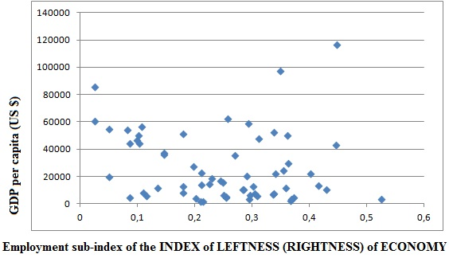
The Institute of Economics
Azerbaijan National Academy of Sciences
Some Results on sub-indices
(Employment regulation sub-index)
State intervention in employment, i.e. moving Economy towards “LEFT” or “Right” does not influence at GDP per capita.
economics.com.az
24th World Congress of Political Science - July 23-28, 2016 | Poznań, Poland

Slide 12
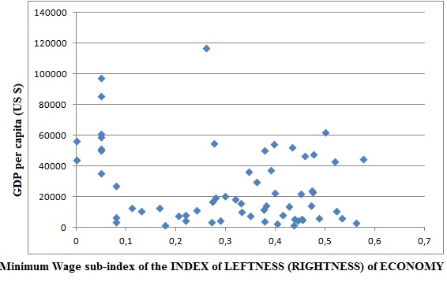
The Institute of Economics
Azerbaijan National Academy of Sciences
Some Results on sub-indices
(Minimum wage sub-index)
It is NECESSARY condition (but is not a sufficient condition !) to have Minimum wage sub-index less than 0,09 (RIGHT) or at interval 0,3-06 (LEFT) to have GDP per capita more than 20.000 US $.
economics.com.az
24th World Congress of Political Science - July 23-28, 2016 | Poznań, Poland

Slide 13
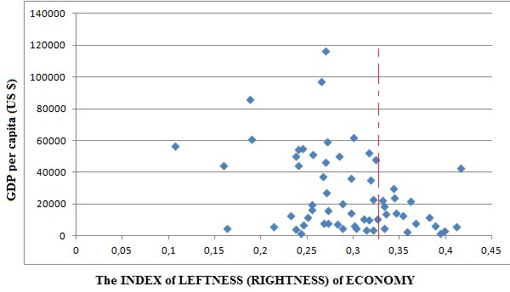
The Institute of Economics
Azerbaijan National Academy of Sciences
Some Results on the INDEX of LEFTNESS (RIGHTNESS) of ECONOMY
It is NECESSARY condition (but is not a sufficient condition !) to have the INDEX of LEFTNESS (RIGHTNESS) of ECONOMY less than 0,325 to have GDP per capita more than 40.000 US $.
economics.com.az
24th World Congress of Political Science - July 23-28, 2016 | Poznań, Poland

Slide 14
Judge a man by his questions rather than his answers…
Voltaire

